Slide 1
Ccbr1045 Update
2020.3.18

Slide 2
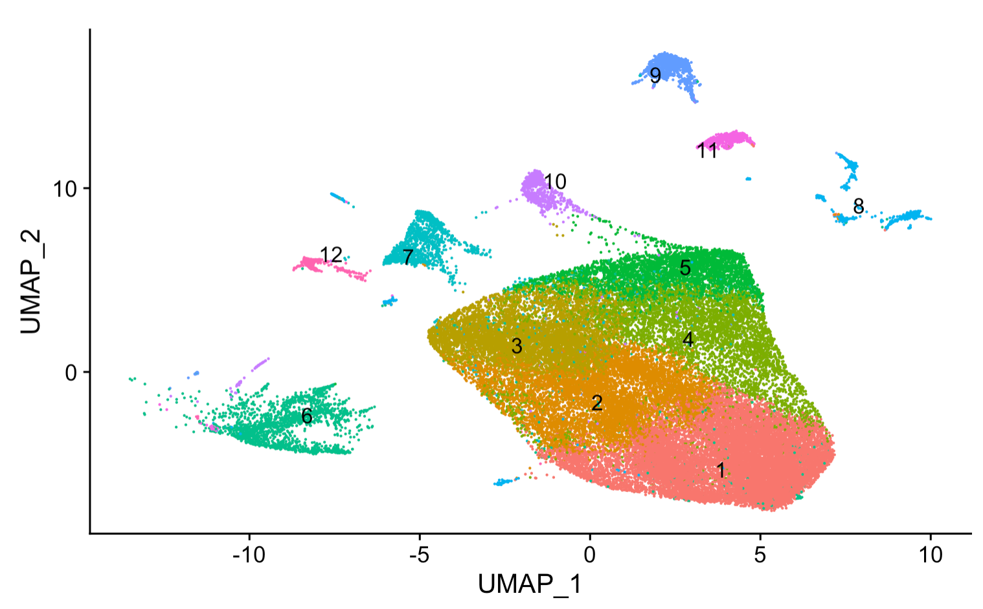

Slide 3
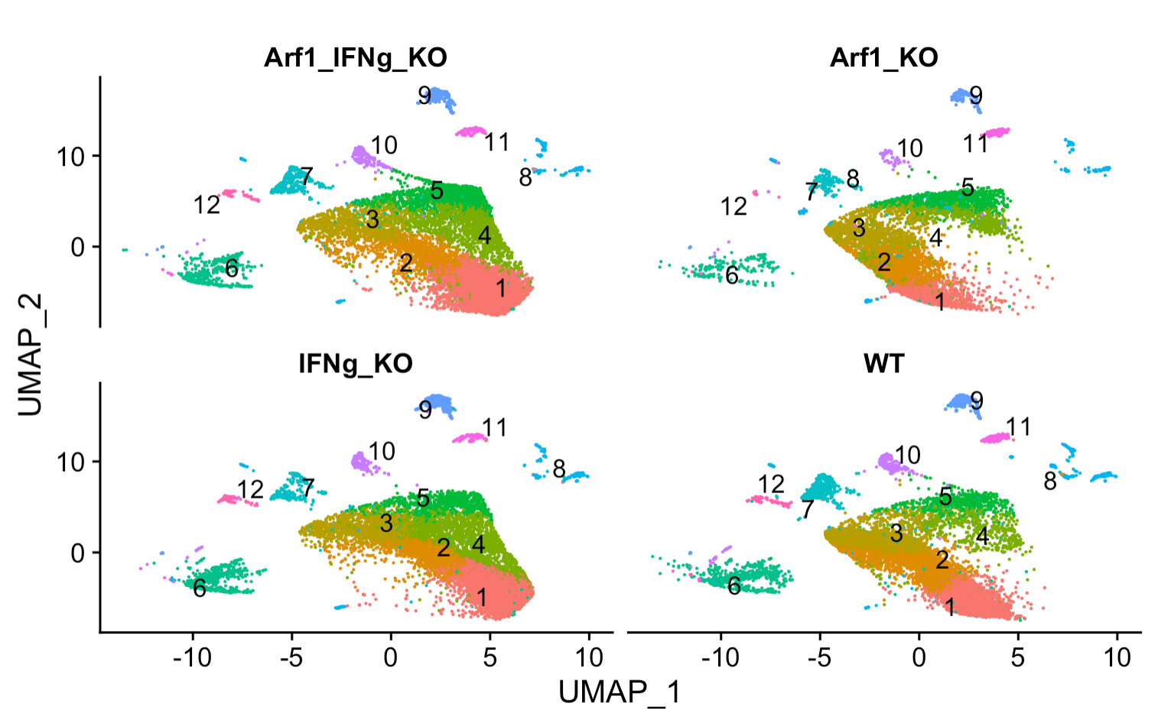
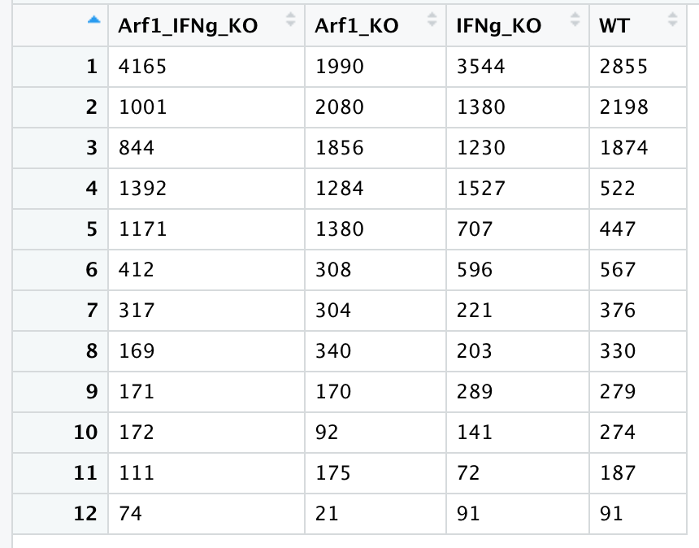
Only microglia cells – reshaped with 0.3 resolution into 12 microglia subclusters
Number of microglial cells for each cluster in each sample

Slide 4
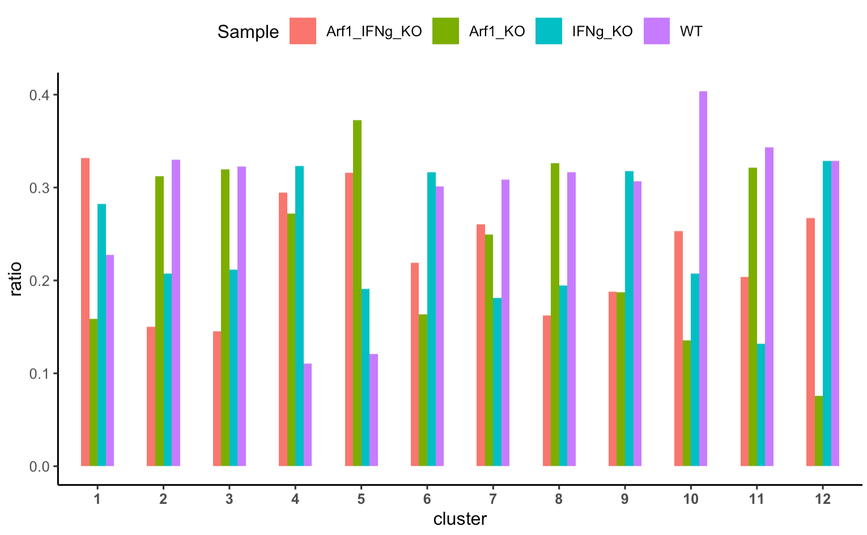
Arf1_KO is enriched in Cluster 5
depleted
enriched
***
***
depleted
depleted
depleted
***
***
***
Chi-square test: P < 0.05 Sig
Notes:
cluster13.061809e-414.408523e-1171.463532e-211sigsigcluster25.324500e-021.578925e-373.133855e-97nsnscluster37.807314e-013.716381e-333.241908e-96nsnscluster42.514975e-802.984808e-063.437892e-02sigsigcluster52.295357e-1213.120161e-542.121216e-05sigsigcluster61.721496e-162.082738e-192.597737e-04sigsigcluster78.583888e-034.063192e-046.277701e-01signscluster87.407008e-015.617508e-093.288811e-14nsnscluster91.493100e-062.370031e-079.806000e-01signscluster101.039198e-173.695263e-037.801740e-06sigsigcluster115.981977e-013.197678e-112.528252e-04nsnscluster125.737170e-095.360490e-091.739415e-06sigsig

Slide 5
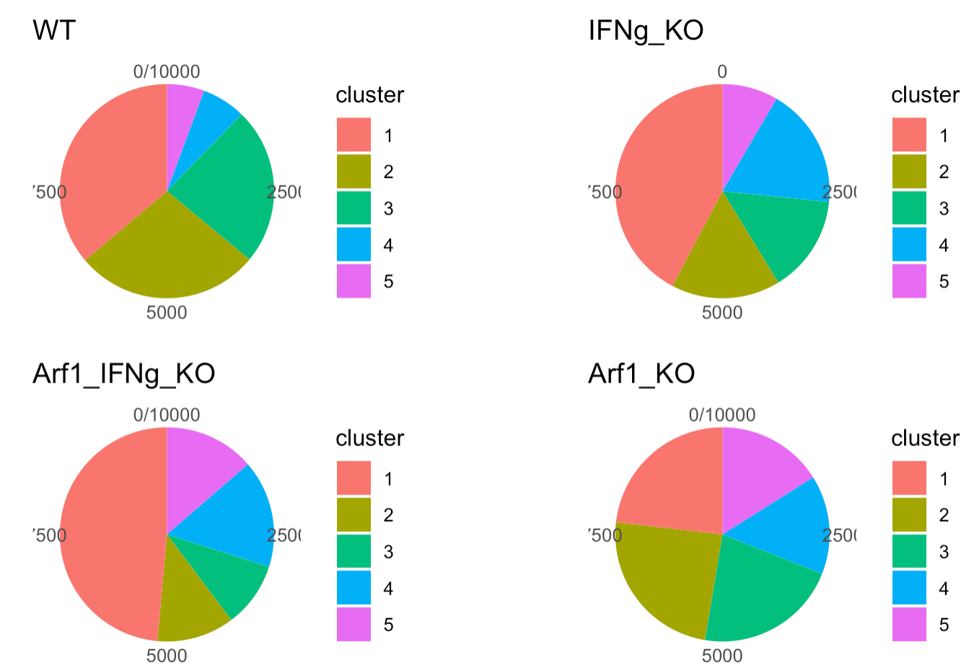
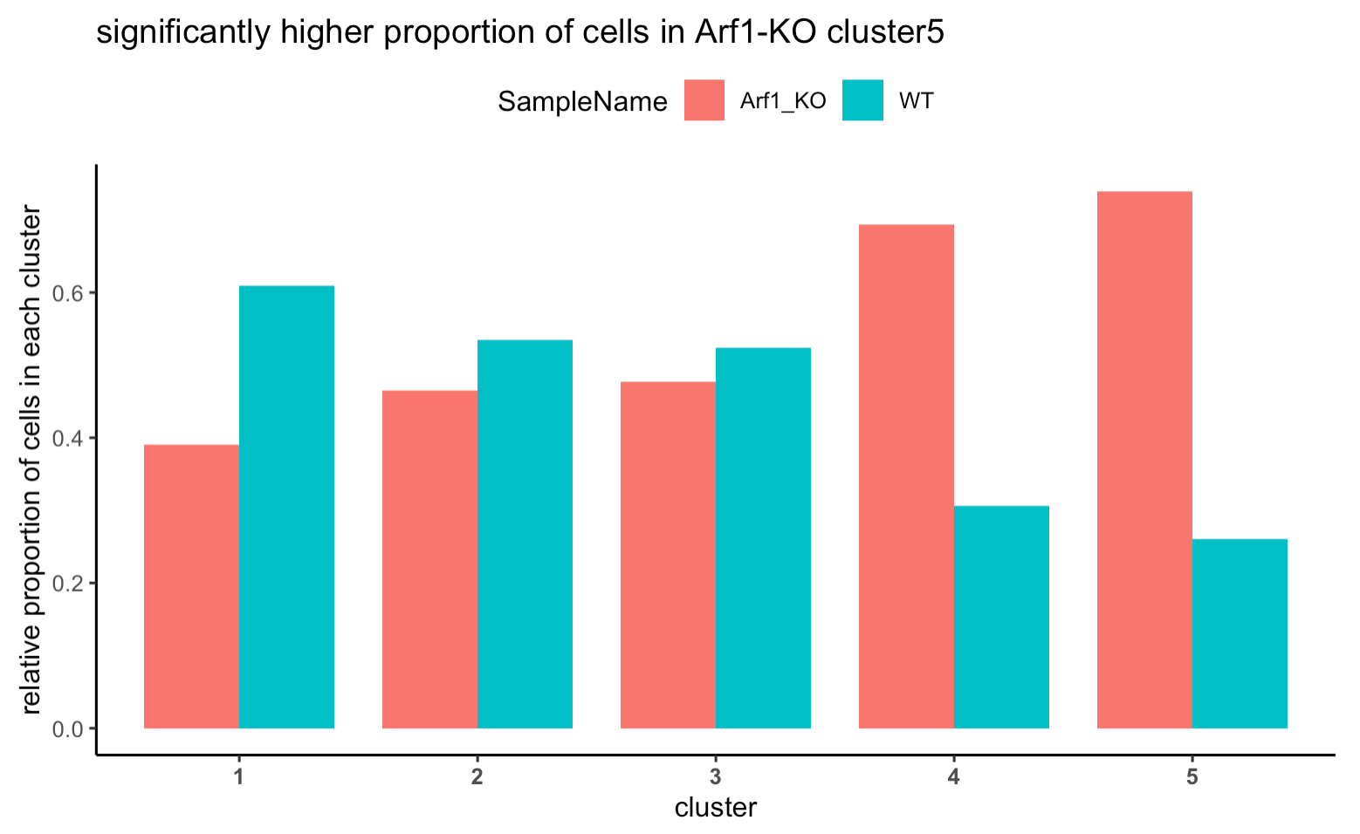
P = 5.54e-129
Relative proportion cluster

Slide 6
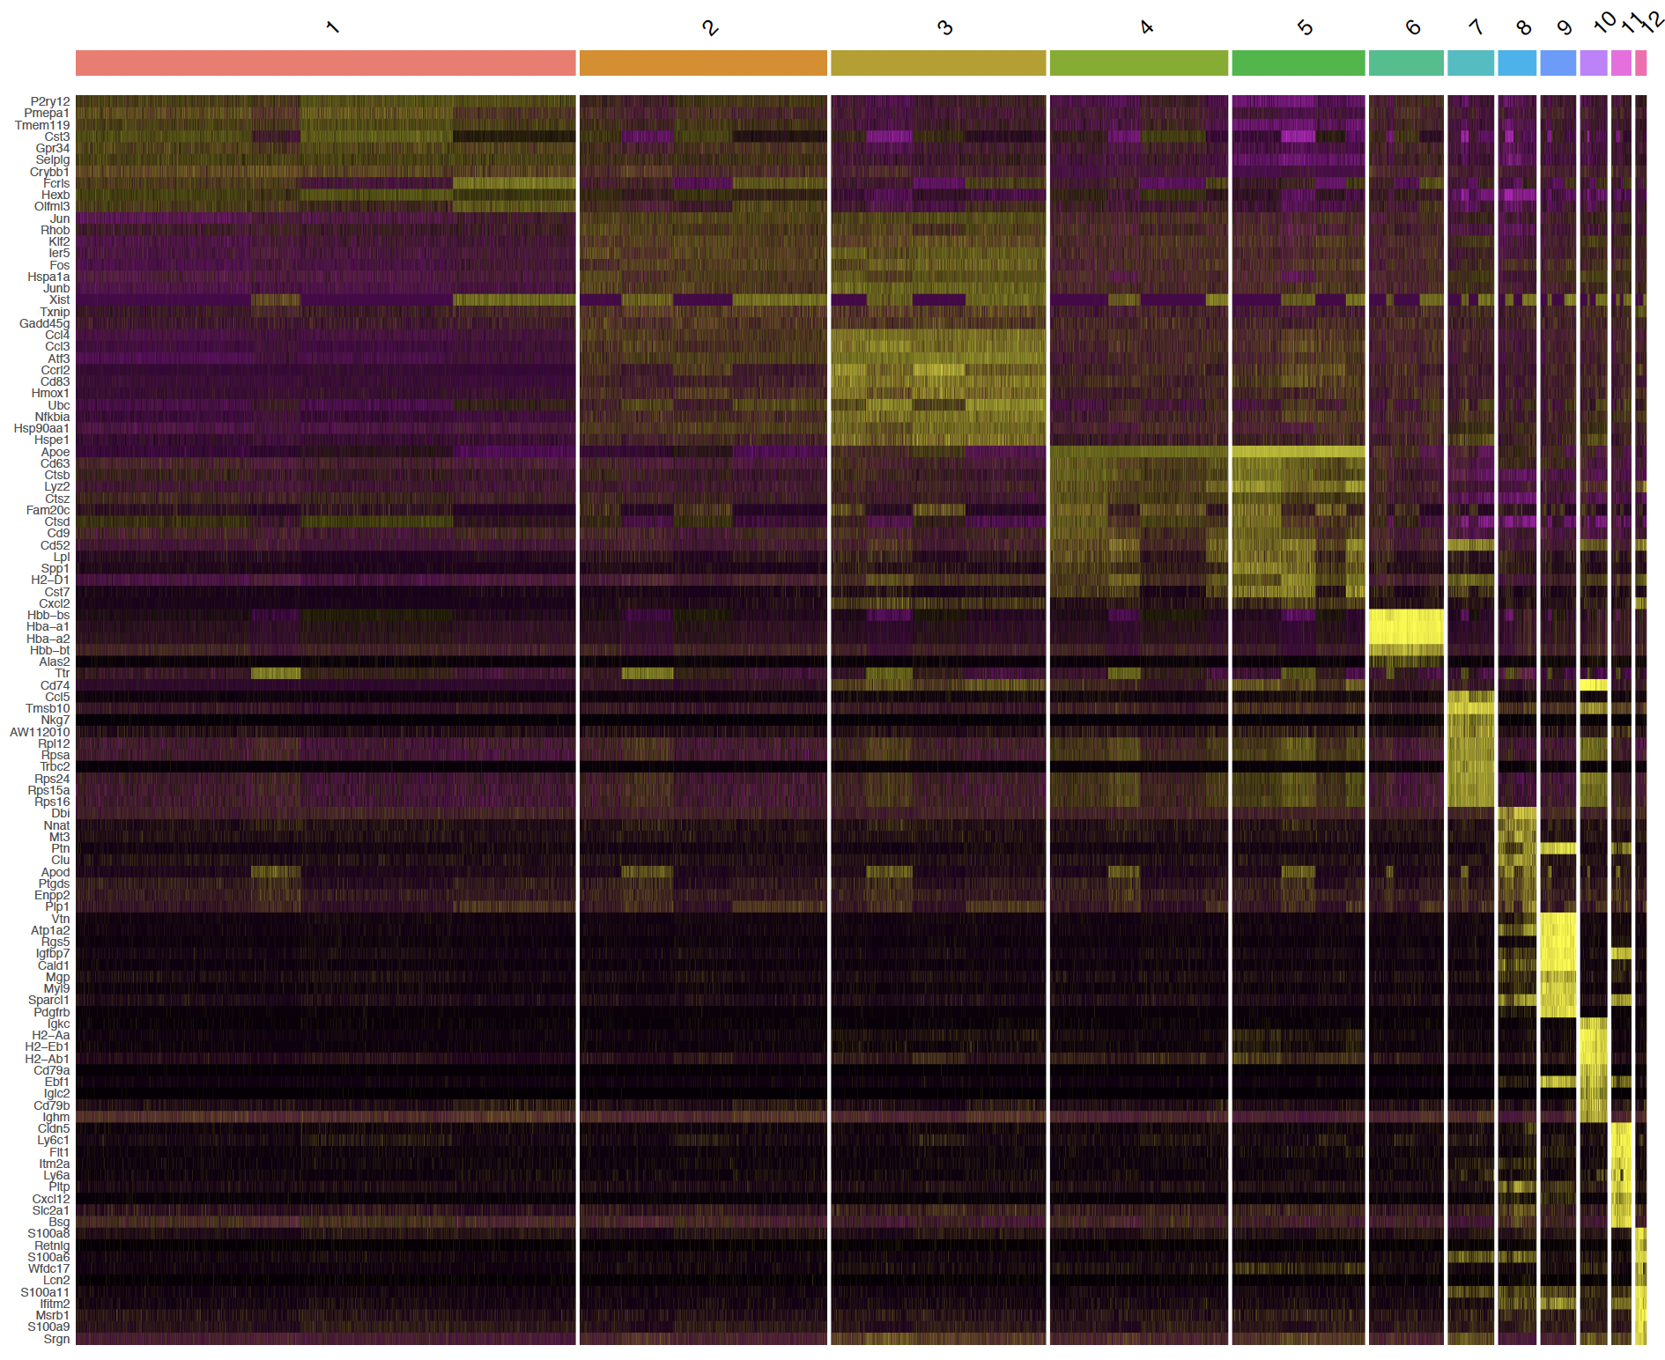
Markers (top 10 by average fold change) for each microglia subcluster

Slide 7
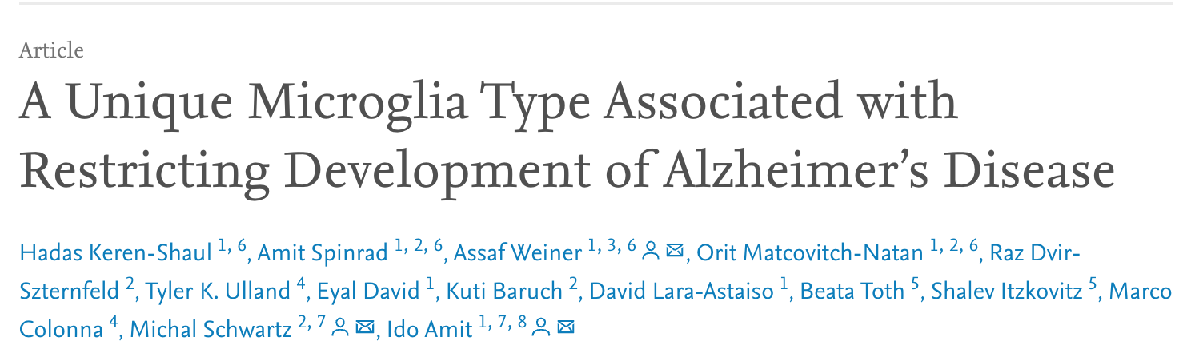
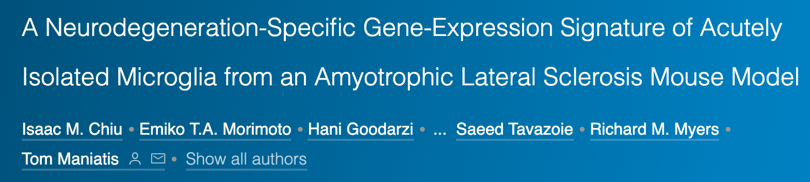
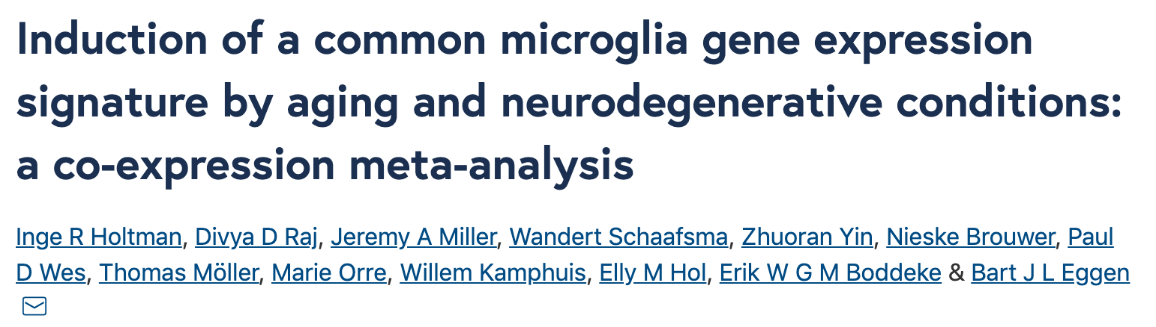
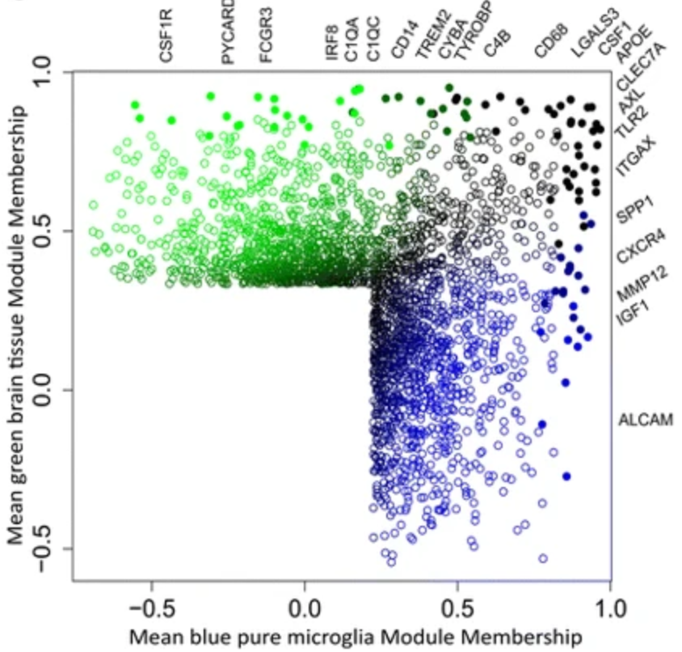
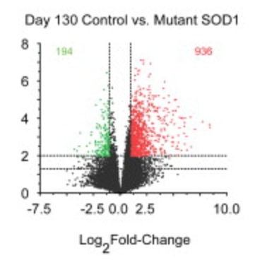
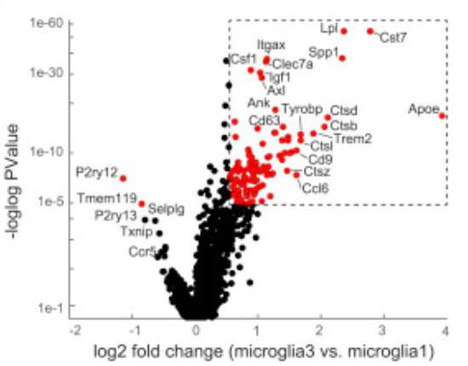
Alzheimer’s disease (AD)
Amyotrophic lateral sclerosis (ALS)
aging
Signed.value = sign(logFC) * log10(Pvalue) * abs(logFC) * -1
Disease
-
normal
Arf1 - WT

Slide 8
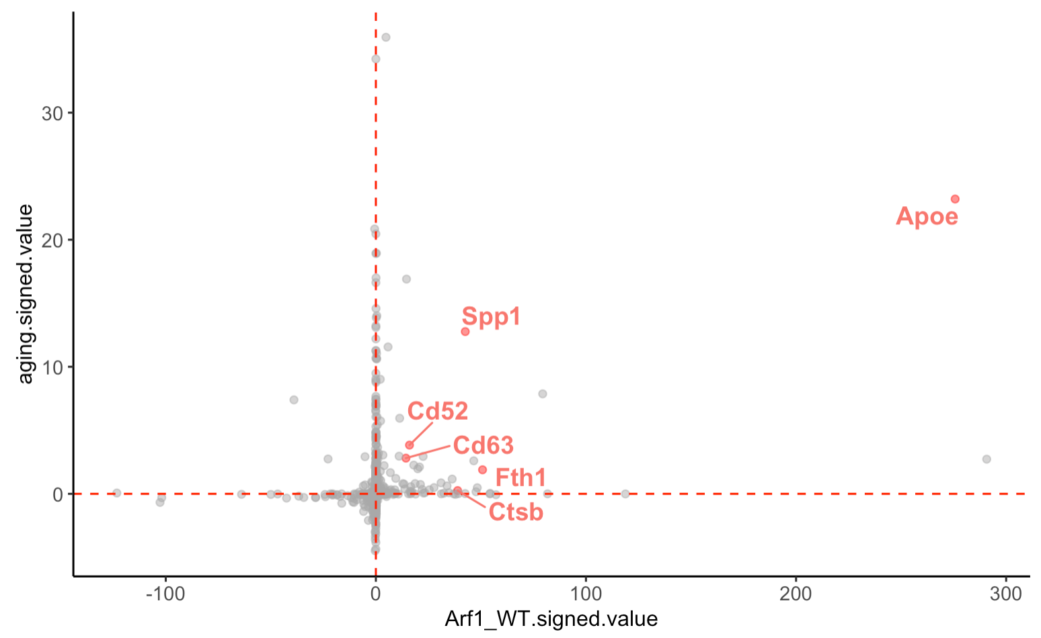
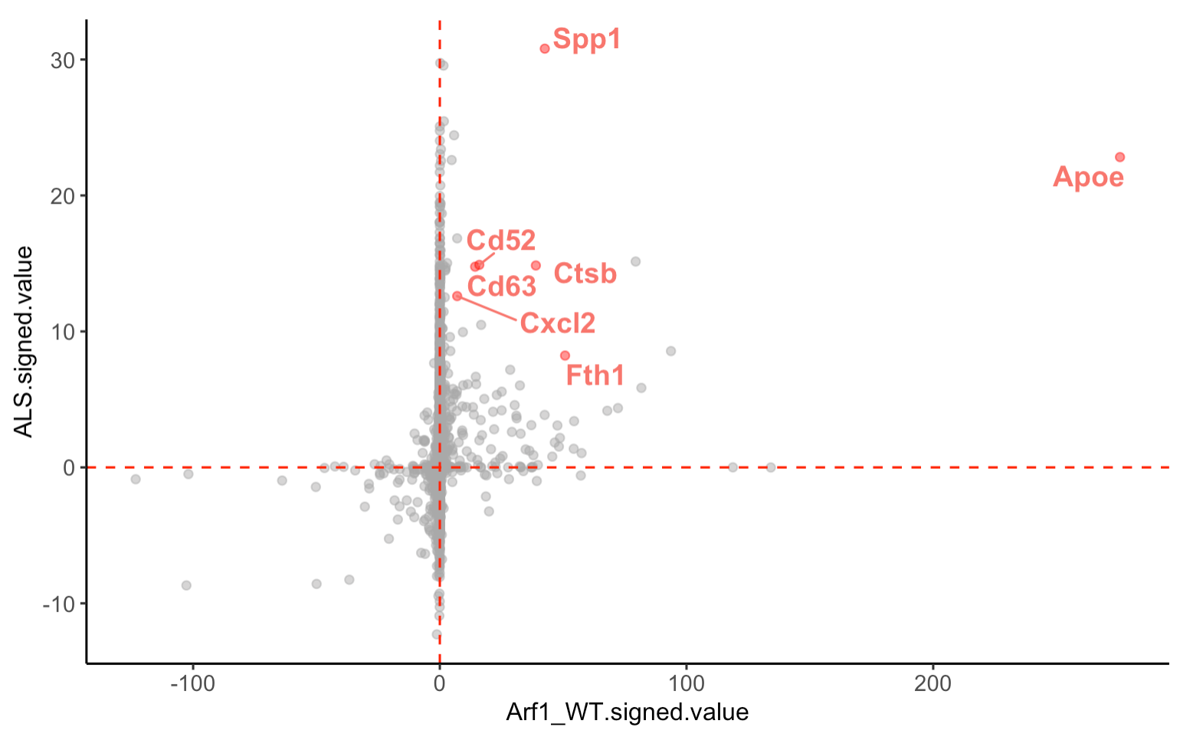
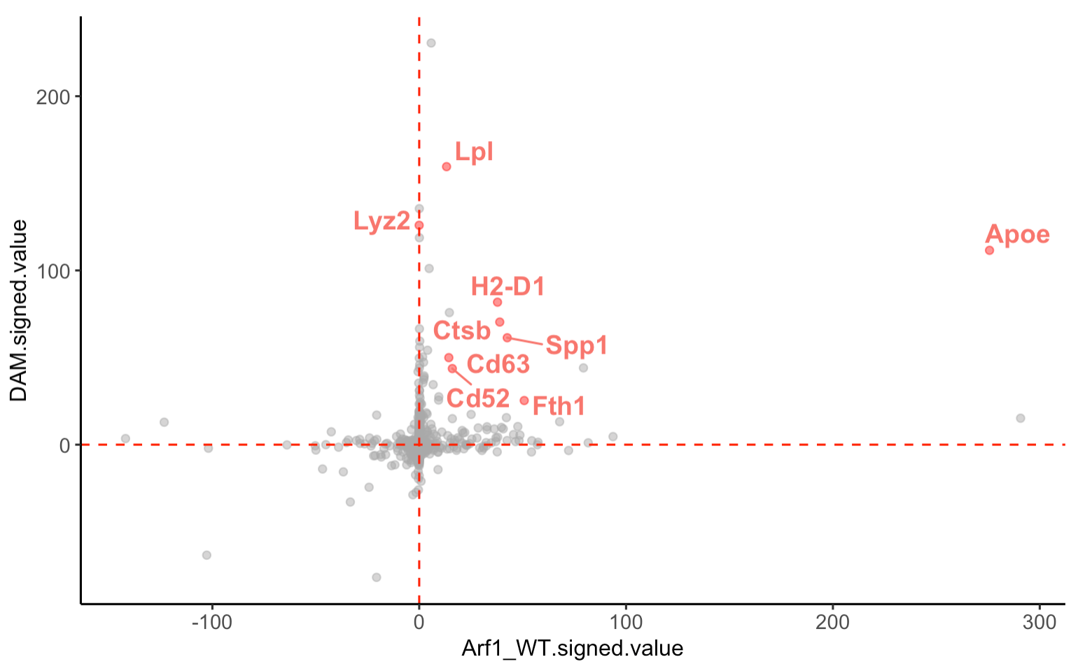
Aging
Top markers in both Cluster 5 and Arf1 include some of the well-known neurodegenerative disease risk genes
Amyotrophic lateral sclerosis (ALS)
Alzheimer’s disease (AD)
late-onset
Alzheimer's disease
Notes:
The most common gene associated with late-onset Alzheimer's disease is a risk gene called apolipoprotein E (APOE).

Slide 9
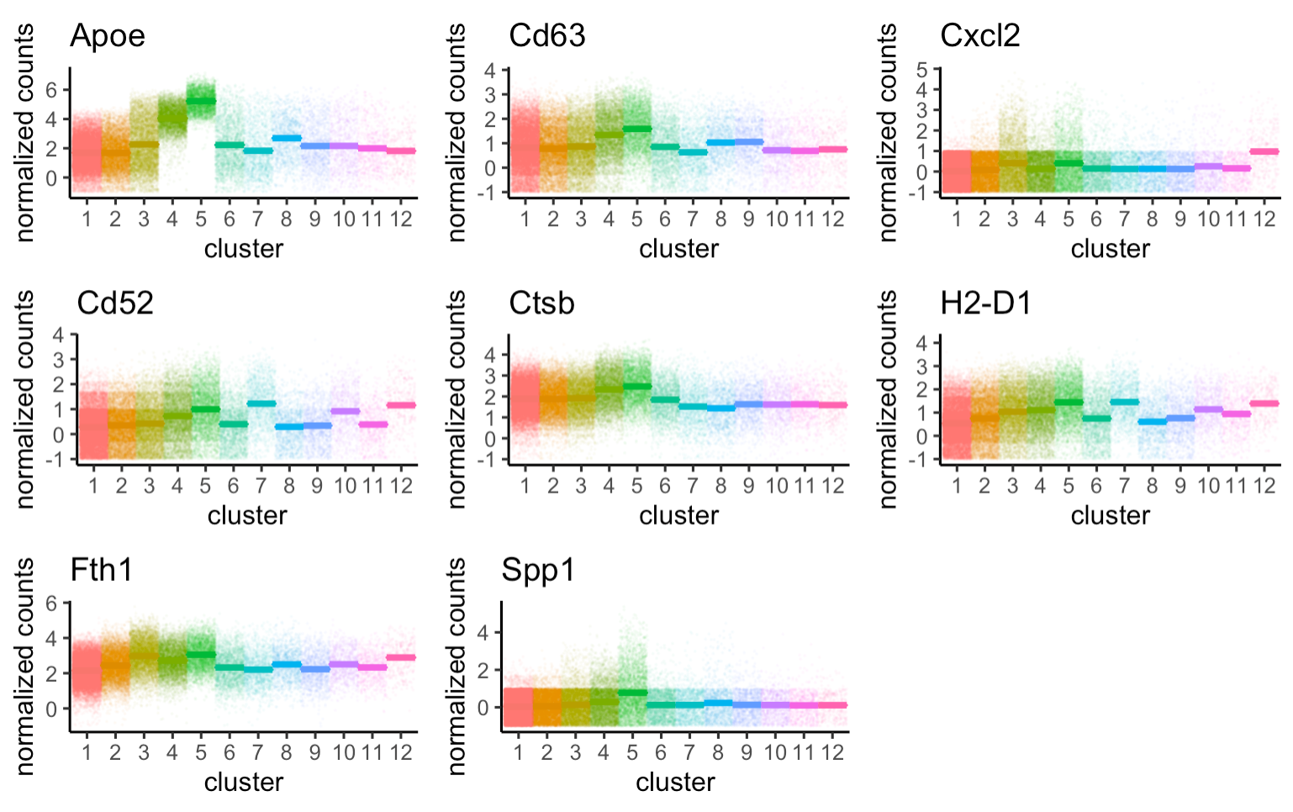
associated with late-onset Alzheimer's disease
Top markers for Cluster 5 include many known disease risk factors
Notes:
The most common gene associated with late-onset Alzheimer's disease is a risk gene called apolipoprotein E (APOE).

Slide 10
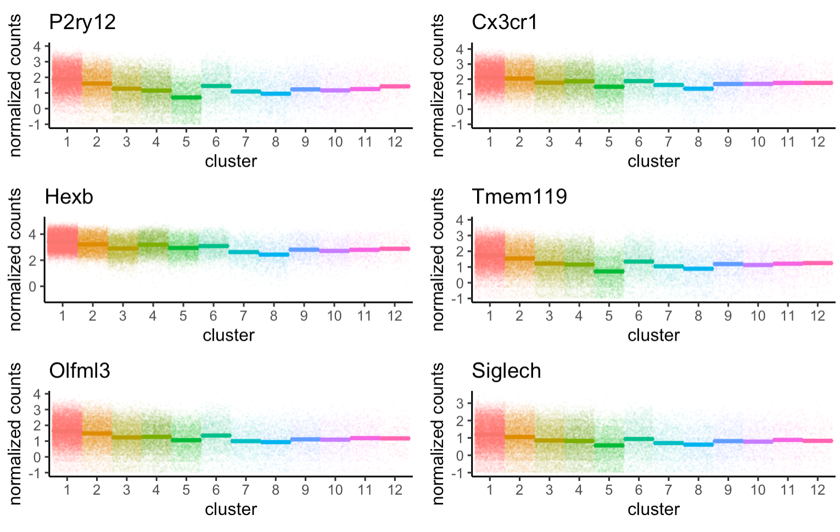
Top marker of Cluster 1 include mostly “microglial marker genes”

Slide 11
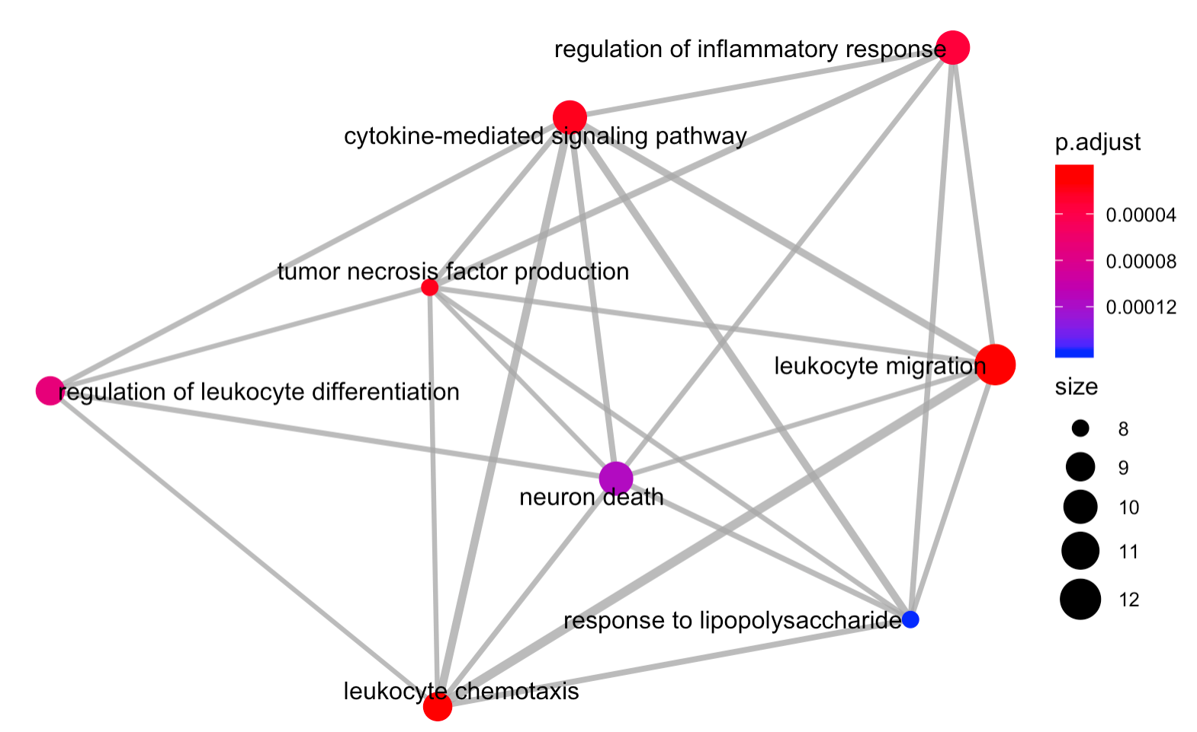
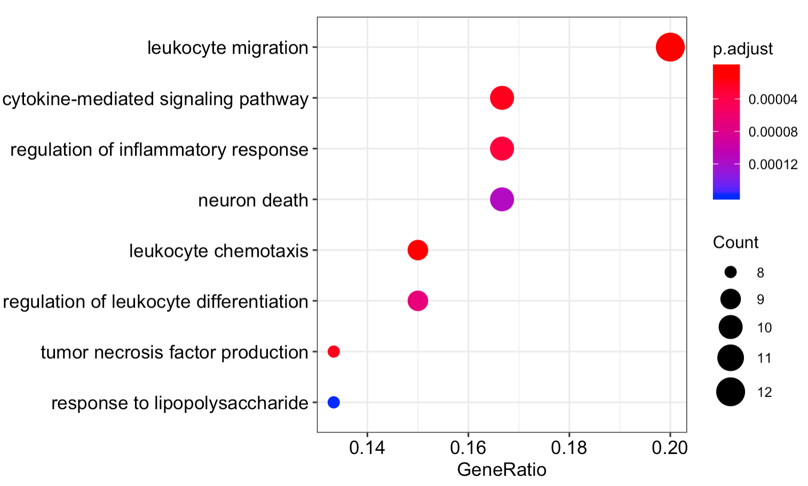
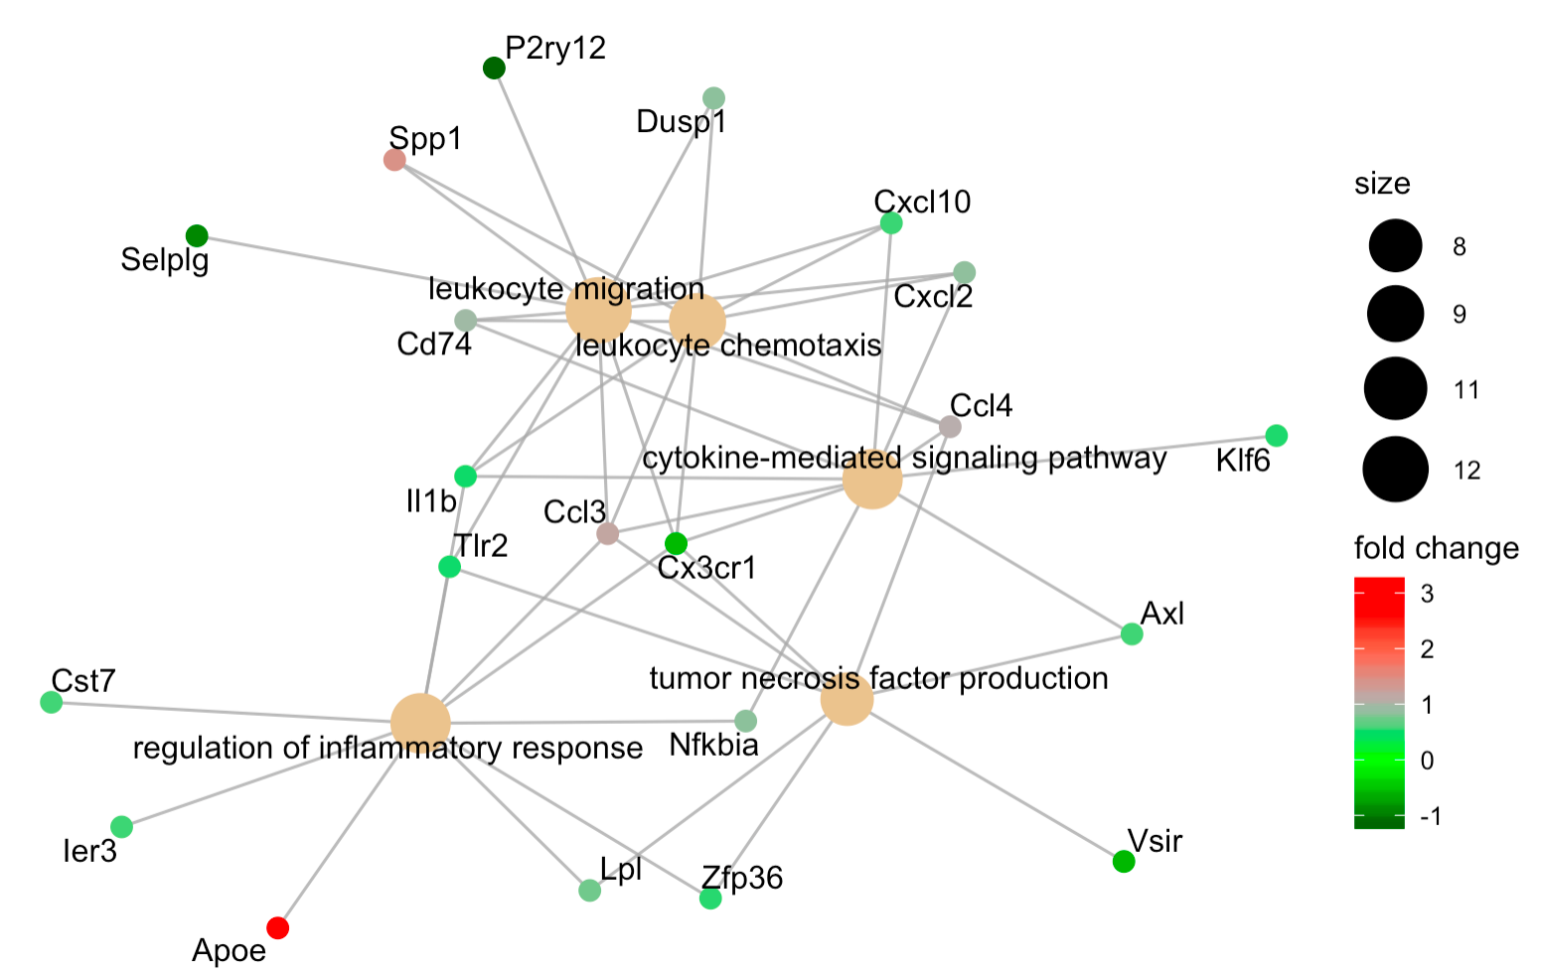
Cluster5 - enriched pathways
From file: myCluster5_cluster1_deg_ORA

Slide 12
To-do for Da
Plot that shows shift of cluster 1-5 for Arf1 and WT(density plot doesn’t look good, so will stick with bar plot)
Transfer microgliaReshape to Biowulf and FindAllMarker for each cluster(biowulf) and Doheatmap
Plot that shows Arf1 and WT cluster 5-1 degs are very similar (also INFg and Arf1_INFg)
Total of three to make: 1. Arf1-WT, Arf1-IFNg, Arf1-Arf1_IFNg, IFNg-WT, Arf1_IFNg-WT. (biowulf swarm job) 2. FindAllMarkers 3. Cluster5 – Cluster1
Heatmap(up and down-regulated genes for Cluster5 – Cluster1, and Arf1-WT degs),
Heatmap of cluster1-5 to show clustering

Slide 13
To do for Guohao
Look into myCluster5_cluster1_deg_ORA and decide which pathways to do dotplot, which ones to show network

